Slide 1
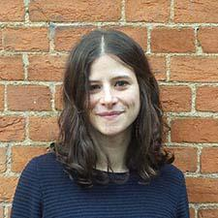
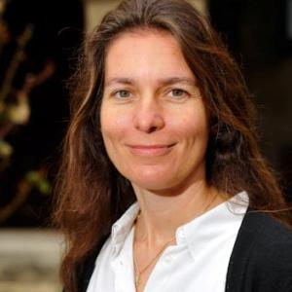
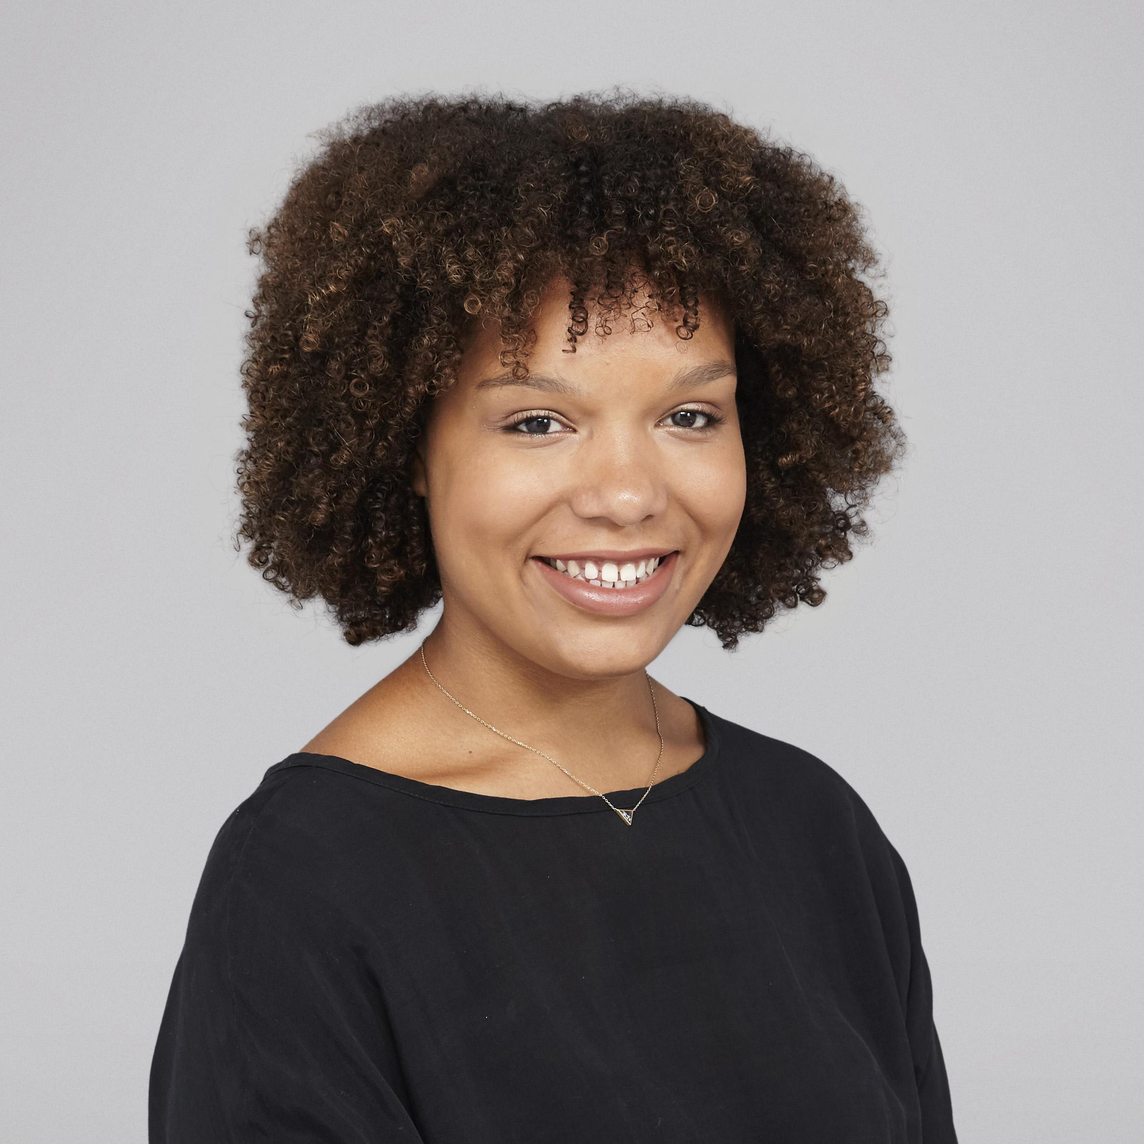


Women in Science
Lucie Charles
Post-doc in Cognitive Neuroscience, UCL
Anne Christophe
CNRS Senior Researcher, Unit Director (LSCP), ENS
Aude Nyadanu
PhD student in Chemistry, X-ENS
L'Oréal-UNESCO Prize
Email: womeninsciencedec@gmail.com
Resources: https://ensdeclife.wixsite.com/declife/ women-in-science
With thanks to:
Notes:
Lucie Charles - Website
Anne Christophe - Website
Auda Nyadanu - LinkedIn

Slide 2
Today
Short opening
Panel
Q&A

Slide 3
Why this panel?
To have a more informed discussion
Learn from each other’s experiences
Acknowledge and deal with biases
Improve! We are the scientific community

Slide 4
Representation
1
Notes:
A key issue is often a lack of representation

Slide 5
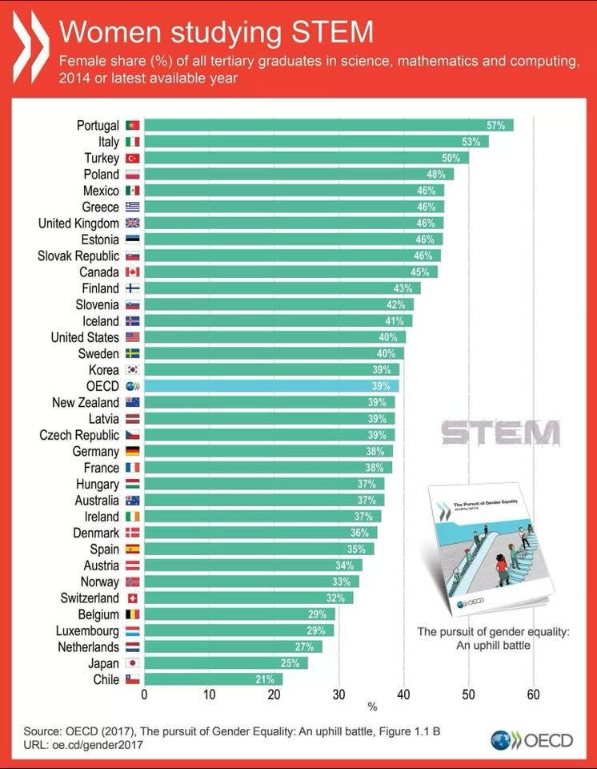
Inequalities in STEM
Percentage of women in higher education:
OECD average: 39%
In France: 38%
Notes:
http://www.oecd.org/gender/the-pursuit-of-gender-equality-9789264281318-en.htm
Humanities is normally balanced, or women are sometimes overrepresented, but they are often underrepresented in Philosophy (e.g. here)
See also:
Else 2018 - Larger gender pay gap in sciences than other companies in UK

Slide 6
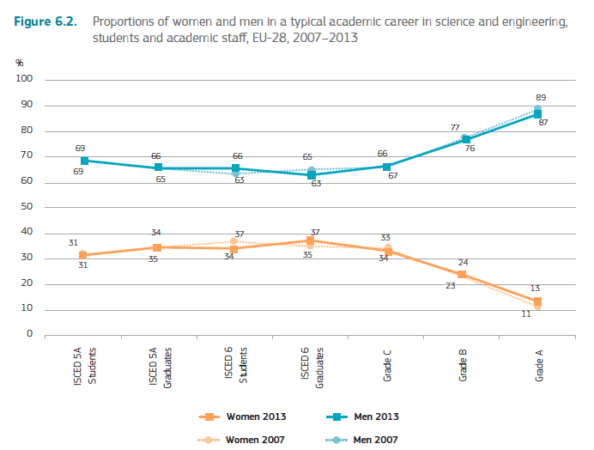
Glass Ceiling
EU-28 average, in science and engineering:
CNRS Mission pour la place des Femmes
Across disciplines, percentage of women:
Higher Education: 55%
Doctorate: 48%
Funded Doctorate: 43%
Researchers: 35%
Rapport de situation comparée 2016
BSc
PhD
Post-doc
PI
Professor
EU Commission, SHE Figures 2015
Notes:
CNRS 2016 rapport
EU SHE figures
(EU Academic Grades explained here, p. 121)
See also:
Titone et al 2018 - Glass ceiling and reduced funding granted for women in cognitive psychology and cognitive neuroscience, in Canada, based on data from the Natural Sciences and Engineering Research Council (NSERC)

Slide 7


Agence Nationale de la Recherche (ANR)
2018 Governing Board
Representatives of the major scientific domains:
Overall:
- M. Jean-François BALAUDÉ
- M. Antoine PETIT
- M. François JACQ
- M. Yves LEVY
- M. François SILLION
- M. Christophe GÉGOUT
- substitute: Mme Lise DUMASY
- substitute: Mme Stéphanie THIÉBAULY
- substitute: Mme Christine CHERBUT
- substitute: Mme Carine GIOVANNANGELI
- substitute: Mme Catherine GARBAY
- substitute: Mme Sophie AVRIL
18
9
Order of the Ministry of Education, 07/03/2018
Notes:
https://www.legifrance.gouv.fr/affichTexte.do?cidTexte=JORFTEXT000036705191

Slide 8
Invisibility
Less likely to be invited for conferences, colloquia, across disciplines
Women are less likely to speak up or ask questions, e.g. in seminars, classes, conferences
Hinsley et al, 2017; Moore-Cantwell, 2017; Nittrouer et al, 2017
Notes:
Nittrouer et al 2017 - Gender disparities at colloquia - in US, across biology, bioengineering, political science, history, psychology, sociology
Hinsley et al, 2017 - at Biology conferences, men ask more questions than women
Moore-Cantwell, 2017: Data were collected at a linguistics conference in NYU in 2017. The tendency of men to talk more is more strongly pronounced in students than in professors.
See also:
Ford et al 2018 - Gender inequalities at American Geophysical Union Fall Meeting, even relative to the proportion of women in the field

Slide 9
Self-confidence
Men tend to be overconfident
Physiology undergrads (N=202):
Average man thinks he is smarter than 66% of class
Average woman: 54%
“Impostor syndrome”
Cooper et al, 2018;
Bernard et al 2017
Notes:
Cooper et al 2018 - Overconfidence in men
Sakulku & Alexander 2011 - “Impostor”phenomenon:
Bernard et al 2017 - Impostor Phenomenon + gender/race discrimination contribute to mental health problems
Atlantic article on The Confidence Gap

Slide 10
Publication
2

Slide 11
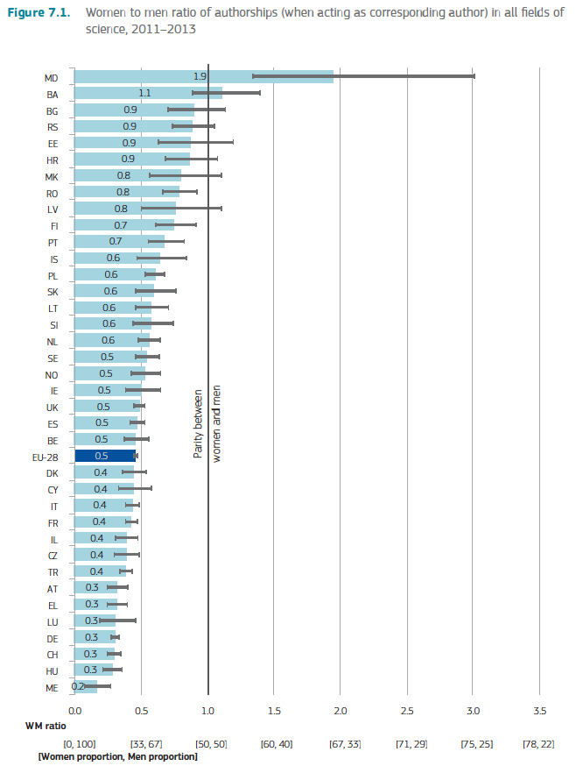
Inequalities in Publications
EU-28 average, across disciplines:
Women as corresponding authors:
31% of publications
I.e. half of men’s publications
Less than the proportion of women/men in academia (~40%)
Larger inequalities in STEM
EU Commission, SHE Figures 2015
Notes:
EU SHE figures

Slide 12
Women publish less – but are more readable
In the field of economics, publications by women get more scrutiny by the editor
Peer reviews take ~6 months longer
Consequently, women’s papers are more readable than men’s
Hengel, 2017
Notes:
Hengel 2017 - One reason for women’s lower productivity is higher scrutiny. Women initially receive more rejections from editors and therefore submit only after long rounds of self-reviews. As a result, their writing improves more - a senior female researcher is 9% better in writing than her male colleague.

Slide 13
Women supervisors benefit women
Women PhD students publish more papers and are 50% more likely to become academics when supervised by women
Gaule & Piacentini, 2018
Notes:
Gaule & Piacentini, Res. Policy, 2018, 47, 805 - advisor gender and academic careers

Slide 14
Parenthood
3

Slide 15
Our expectations of parents is different
Women
Are expected to be the main caretakers
Are also expected not to let it affect their work
Men
Struggle with expectations that their career should be no. 1
Notes:
Women find themselves between a hammer and a hard place: on the one hand, they are expected to be the main caretakers; on the other, they are expected to do as much as they have before

Slide 16

Two married colleagues each brought their son to a lecture because daycare closed last-minute. This was mentioned in both of their student evaluations. Try to guess which prof was called "unprofessional" and which was described as "a great parent".
T. Ryan Gregor, biology prof, Ontario
Notes:
https://mobile.twitter.com/TRyanGregory/status/991819905677881344?s=19

Slide 17
… but parents in academia share many problems
Mobility: leaving the support network for a post-doc/job
Going to conferences
Networking
Though more likely to affect women
Notes:
There are some things we can do as organizers of conferences and events, that would make the lives of parents easier! For example, try and have events at times that are comfortable for parents (like now).
Psychonomic Society provides Family Care Grants to support the financial costs of parents attending conferences, like babysitting.They also have an award for junior women scientists to support travelling to conferences and promote networking.
The Experimental Psychology Society also has a Carers Fund.

Slide 18
Mental health in Academia
4

Slide 19
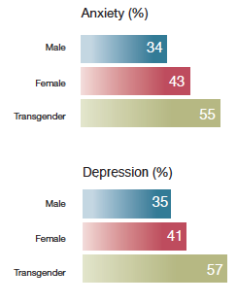
Depression and anxiety
General problem in academia, but affects women and transgender people more
Online Survey (N = 2279)
across 26 countries
mostly PhD candidates
Evans et al, 2018
Notes:
Evans et al. 2018 - Online survey
Nature had a 2017 survey showing similar stats, and started a special collection on the issue of mental health in academia in May 2018
Levecque et al 2017 - Similar findings in Belgium PhD students
Recent Research Report requested by Royal Academy and Wellcome Trust, in the UK
See also:
2018 Research Report by Vitae for Higher Education Funding Council for England (now Research England)
And 2017 Research Report by RAND commissioned by the Royal Society and Wellcome Trust

Slide 20
Strategies for progress
5

Slide 21
Examples of helpful strategies
Adapting hiring and promotion procedures
Diversity and equality task-forces
Structured interviews
Adapting peer review procedures
Blind reviews (e.g. curtain test)
Mentorship
Consideration of the needs of parents
Timings of colloquia/seminars
Flexibility in scheduling events
Notes:
Behavioural Insights Unit has many suggestions of strategies demonstrated to be efficient
In the 70’s, orchestras have decided to use a curtain in auditions, which wouldn’t allow the examiners to see who’s playing. In 25 years, the representation of women in orchestras by more than 20%, and increased their chances of making it to the final round by more than 50%. [ref: http://www.nber.org/papers/w5903]

Slide 22









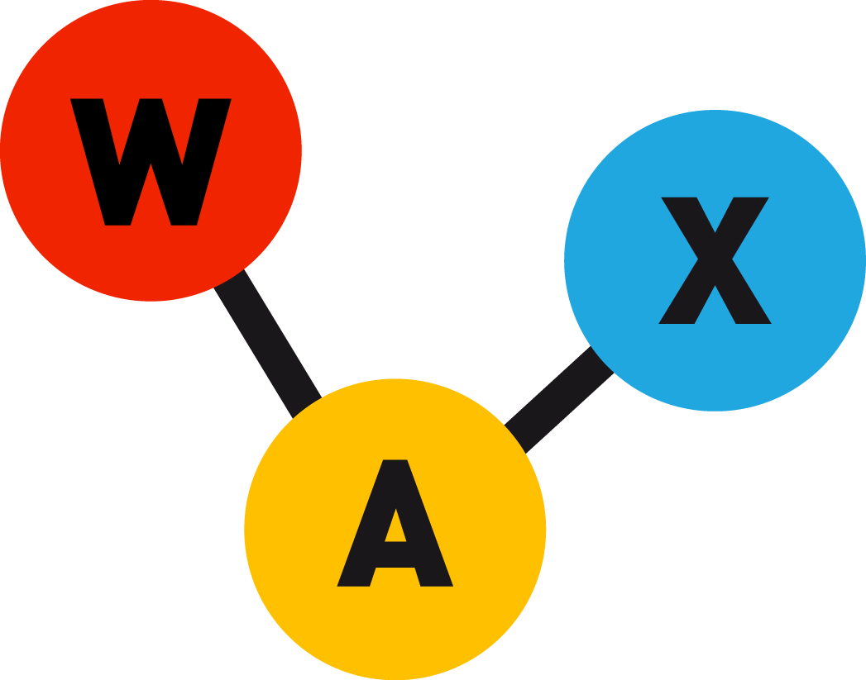



Resources
Notes:
Femmes et Sciences: http://www.femmesetsciences.fr/
Femmes et Maths: http://www.femmes-et-maths.fr/index.php
Women in Cognitive Sciences: http://womenincogsci.org/
Women in Science: https://www.awis.org/
Women in Science database in the UK: https://wisdat.royalholloway.ac.uk/
Association Française des Femmes Diplomés: http://www.affdu.fr/
Elles Bougent: http://www.ellesbougent.com/
L’Oreal-UNESCO Prize: https://www.fondationloreal.com/categories/for-women-in-science/lang/en
Irene Joliot-Curie Prize: http://www.enseignementsup-recherche.gouv.fr/cid129030/prix-irene-joliot-curie-lancement-de-l-edition-2018.html
Meetings about R coding: https://rladies.org/
Behavioural Insights Team, discussing diversity and equality: https://www.behaviouralinsights.co.uk/bx2015/bx2018-diverse-approaches-to-improving-gender-diversity/
WAX Science, promoting a science without stereotypes: https://www.wax-science.fr/
See also:
The Conference Diversity Distribution Calculator - to assess whether there are gender disparities at a conference
SfN Women in Neuroscience - Provides talks and toolkits that offer practical strategies for mitigating obstacles that female neuroscientists may face at various career steps
Psychonomic Society - Family Care Grants, and award for junior women scientists
Experimental Psychology Society Carers Fund - for people with caring responsibilities

Slide 23
Women in Science
Lucie Charles
Post-doc in Cognitive Neuroscience, UCL
Anne Christophe
CNRS Senior Researcher, Unit Director (LSCP), ENS
Aude Nyadanu
PhD student in Chemistry, X-ENS
L'Oréal-UNESCO Prize
Email: womeninsciencedec@gmail.com
Resources: https://ensdeclife.wixsite.com/declife/ women-in-science
With thanks to:
Notes:
Lucie Charles - Website
Anne Christophe - Website
Auda Nyadanu - LinkedIn

